Slide 1

SHREE GURU GOBIND SINGH INSTITUTE OF engineering & technology
(An autonomous Institute of Government of Maharashtra )
A Seminar Presentation on
FACE DETECTION TECHNOLOGY
PRESENTED BY :
POOJA MANDAVKAR 2013BIT008
NAVJYOT KAUR MAAN 2013BIT059
AMBIKA GHADLINGE 2014BIT508
SUMIT PATIL 2014BIT510

Slide 2
Face Detection Technology Using MATLAB
Seminar presentation
on

Slide 3
Index
Topics Involved In Face Detection
Viola Jones Algorithm
Viola Jones Algorithm Features
Project Matter
Project Screen shots

Slide 4
Topics Involved In face Detection
Viola Jones Algorithm
Face Detection
Ada-Boost Algorithms (Adaptive Boost Algorithm)
Integral Image
Cascade Object Detector

Slide 5
Viola Jones Algorithm
Rapid computation of Haar-like features using the integral image;
Classifier learning with AdaBoost to select the best features;
The attentional cascade structure which rejects the majority of the sub-windows in early layers of the detector, making the detection process extremely efficient

Slide 6
Viola-Jones Algorithm Features
Feature Calculation
Feature selection using AdaBoost algorithm
Attentional Cascade

Slide 7
Project Matter
Pages Involved in Project :
Main.m
Face.m
Tools :
All the project was developed with help of Software Matlab 2014a version

Slide 8
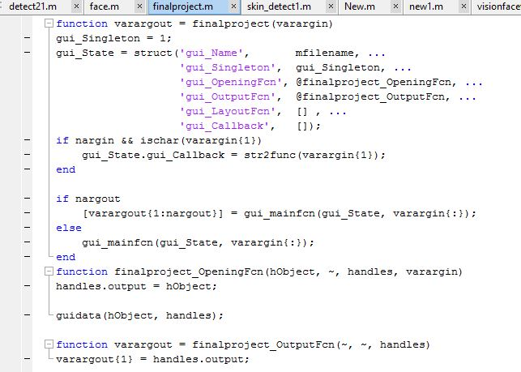
1. Main Page

Slide 9
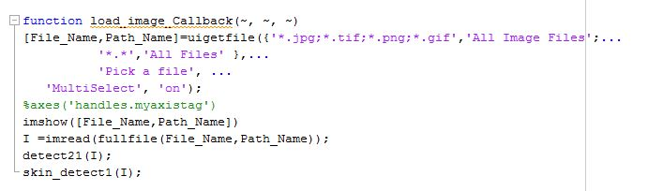
2. Loading Manual Image

Slide 10
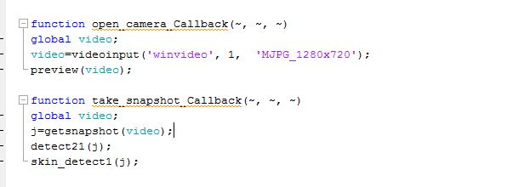
3. Code For Open Camera

Slide 11
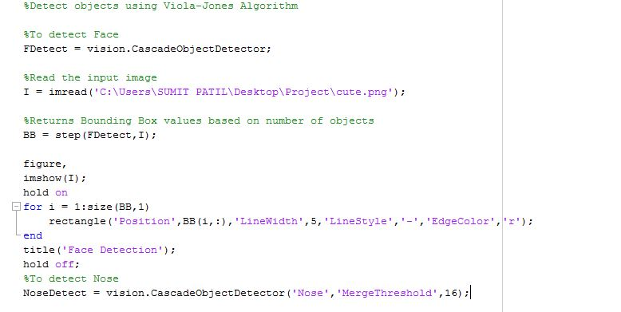
4. Face Detection

Slide 12
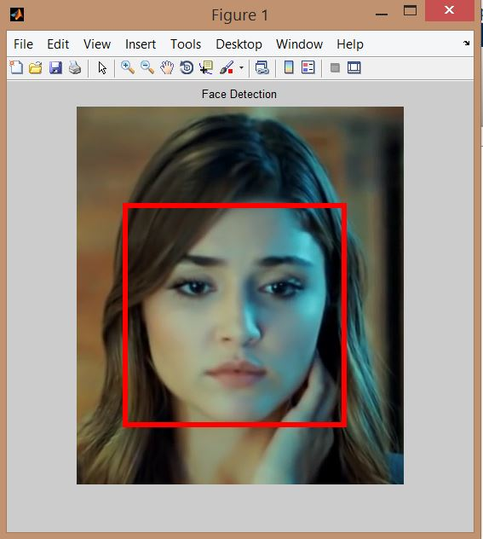
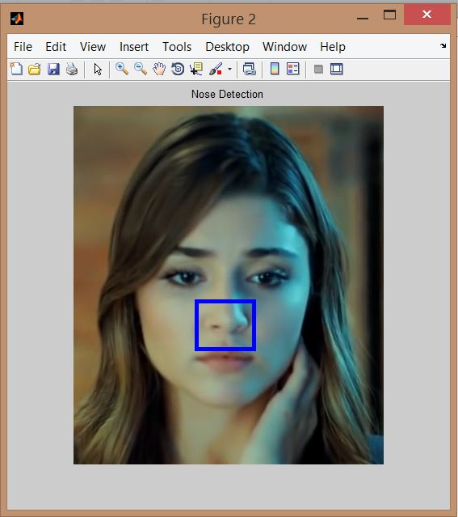
Results
Fig.1 Face Detection
Fig.2 Nose detection

Slide 13
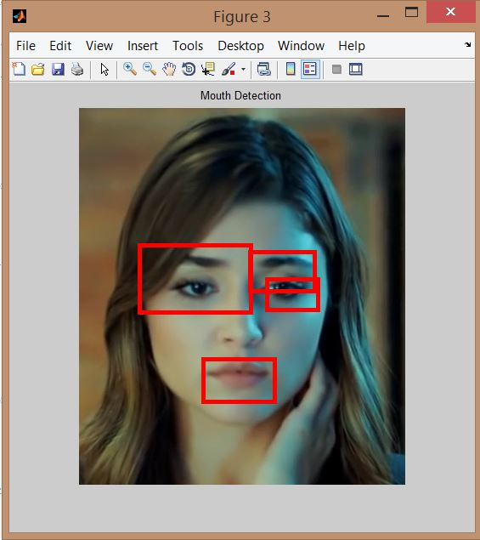
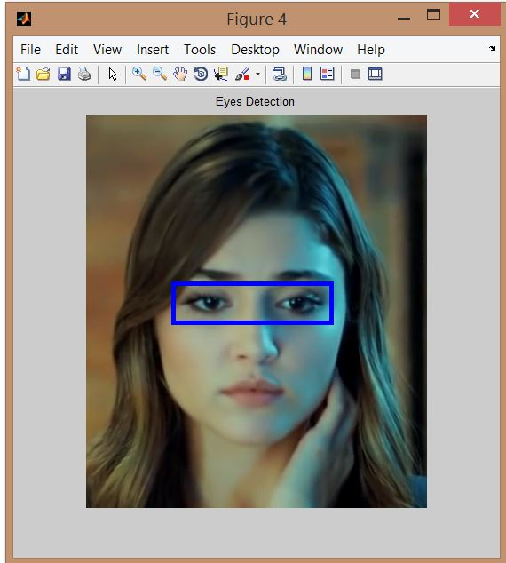
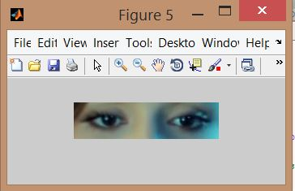
Fig.3 Mouth Detection
Fig.4 Eyes Detection

Slide 14
Disadvantages
Face detection is a difficult task due to the many variations in scale, location, orientation, pose, facial expression, lighting conditions, occlusions etc. For example, in the image I2 people are not placed in the foreground and therefore the results obtained with the 8 detectors are not the best, never obtaining the detection of only 11 faces.
Having in view that the goal of face detection is to determine whether or not there are any faces in an image and, if present, return the image location and extent of each face in real time, the response time of the detector is an important performance.

Slide 15
Conclusion
Using vision.CascadeObjectDetector, a Matlab object system, a face detector based on Viola-Jones algorithm has been developed. Starting from several pretrained classifiers for detecting frontal faces, we used the trainCascadeObjectDetector function to train our face detector classifier, employing a set of positive samples and a set of negative images. Selecting the function parameters, we optimized the number of layers, the false positive rate and the true positive rate, resulting more detectors. Using three different images with 6, 11 and 6 faces, all detectors were tested. To get better results with a higher positive rate, more images are required in the training process.

Slide 16
References
1] www.facereg.com
2] www.Imagestechnology.com
3] www.ieee.com

Slide 17
THANK YOU !!!

